Slide 1
Part 2.10: Vibrational Spectroscopy

Slide 2
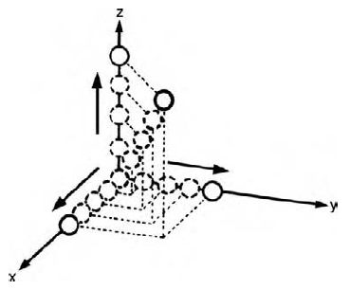
Single Atom
Vibration- Atoms of a molecule changing their relative positions without changing the position of the molecular center of mass.
No Vibartion
“It takes two to vibrate”
No Rotation
A point cannot rotate
Translation
Can move in x, y, and/or z
3 Degrees of Freedom (DOF)
0 Vibrations

Slide 3
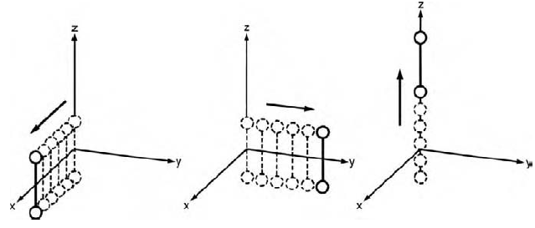
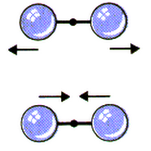
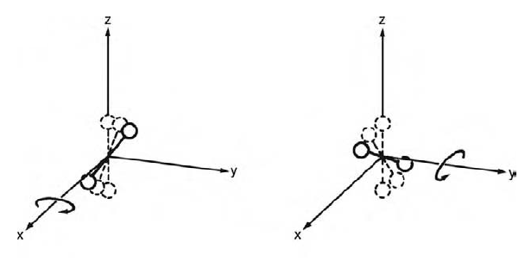
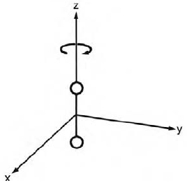
Diatomic Molecule
2 atoms x 3 DOF = 6 DOF
Translation
6 DOF
- 3 Translation
- 2 Rotation
1 Vibration
Rotation
For a Linear Molecule
# of Vibrations = 3N-5

Slide 4
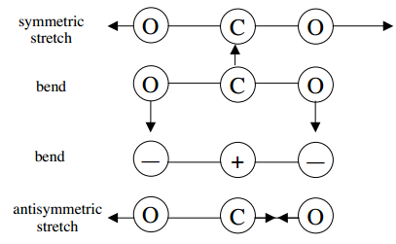
Linear Triatomic Molecule
3 atoms x 3 DOF = 9 DOF
9 DOF
- 3 Translation
- 2 Rotation
4 Vibration
For a Linear Molecule
# of Vibrations = 3N-5
Argon (1% of the atmosphere)-
3 DOF, 0 Vibrations

Slide 5
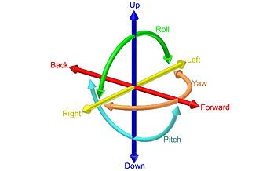
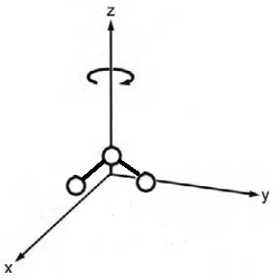
Nonlinear Triatomic Molecule
3 atoms x 3 DOF = 9 DOF
3 Translation
3 Rotation
Linear
non-linear

Slide 6
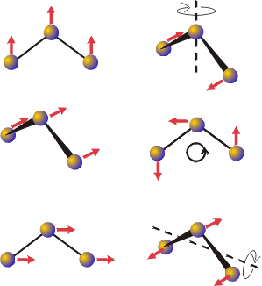
Nonlinear Triatomic Molecule
3 atoms x 3 DOF = 9 DOF
Trans_{z}
R_{z}
9 DOF
- 3 Translation
- 3 Rotation
3 Vibration
Trans_{y}
R_{x}
Trans_{x}
R_{y}
For a nonlinear Molecule
# of Vibrations = 3N-6

Slide 7
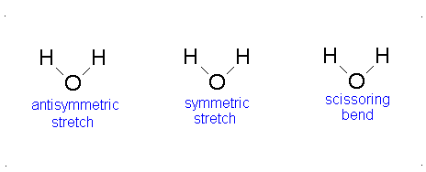
Nonlinear Triatomic Molecule
3 atoms x 3 DOF = 9 DOF
9 DOF
- 3 Translation
- 3 Rotation
3 Vibration
For a nonlinear Molecule
# of Vibrations = 3N-6

Slide 8
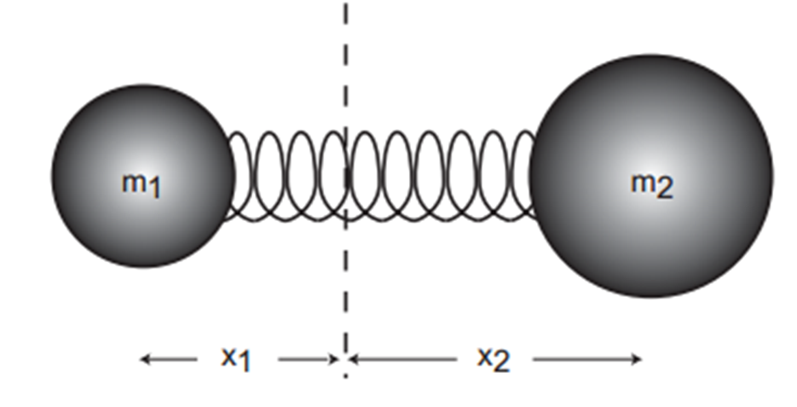
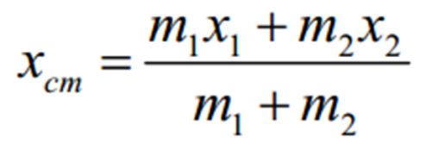
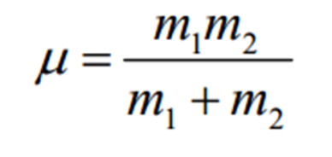
Molecular Vibrations
Atoms of a molecule changing their relative positions without changing the position of the molecular center of mass.
Even at Absolute Zero!
In terms of the molecular geometry these vibrations amount to continuously changing bond lengths and bond angles.
Center of Mass
Reduced Mass

Slide 9
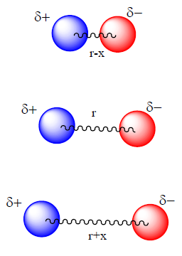
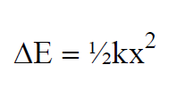
Molecular Vibrations
Hooke’s Law
k = force constant
x = distance
Assumes-
It takes the same energy to stretch the bond as to compress it.
The bond length can be infinite.

Slide 10
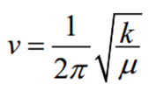
Molecular Vibrations
Vibration Frequency (ν)
Related to:
Stiffness of the bond (k).
Atomic masses (reduced mass, μ).

Slide 11
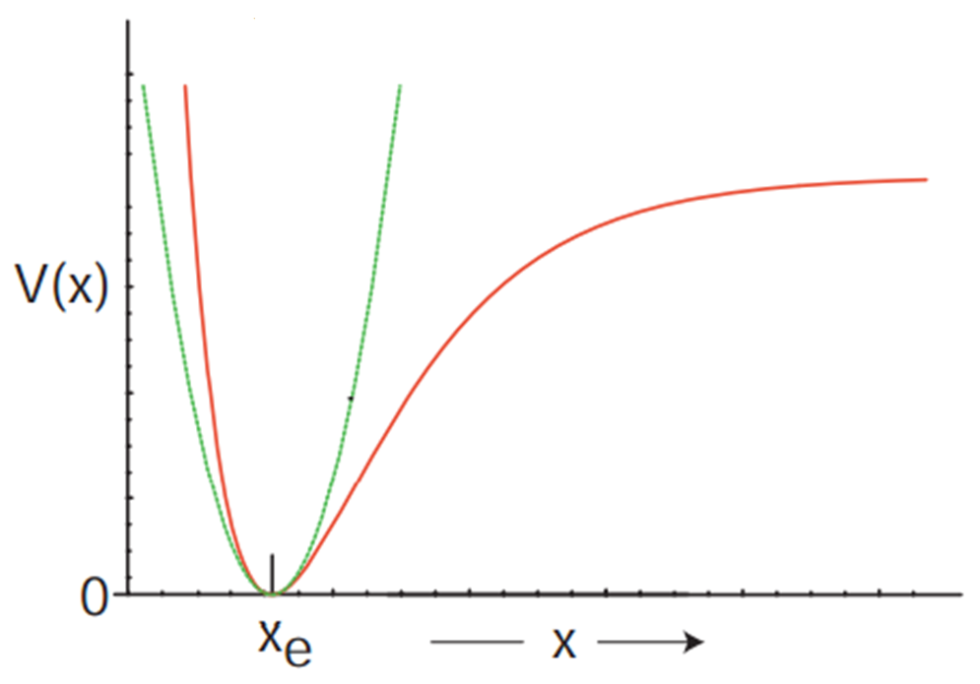
Molecular Vibrations
Classical Spring
Quantum Behavior
Sometimes a classical description is good enough. Especially at low energies.

Slide 12
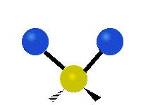
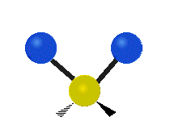
6 Types of Vibrational Modes
Symmetric Stretch
Assymmetric Stretch
Wagging
Twisting
Scissoring
Rocking

Slide 13
Vibrations and Group Theory
What kind of information can be deduced about the internal motion of the molecule from its point-group symmetry?
Each normal mode of vibration forms a basis for an irreducible representation of the point group of the molecule.
1) Find number/symmetry of vibrational modes.
2) Assign the symmetry of known vibrations.
3) What does the vibration look like?
4) Find if a vibrational mode is IR or Raman Active.

Slide 14
1) Finding Vibrational Modes
Assign a point group
Choose basis function (three Cartesian coordinates or a specific bond)
Apply operations
-if the basis stays the same = +1
-if the basis is reversed = -1
-if it is a more complicated change = 0
Generate a reducible representation
Reduce to Irreducible Representation
Subtract Translational and Rotational Motion

Slide 15
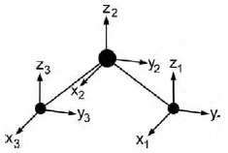
Example: H₂O
Assign a point group
Choose basis function
Apply operations
-if the basis stays the same = +1
-if the basis is reversed = -1
-if it is a more complicated change = 0
C_{2v} point group
Basis: x₁₋₃, y₁₋₃ and z₁₋₃
Atom 1: x₁ = 1
y₁ = 1
z₁ = 1
Atom: 1 2 3
E: 3 + 3 + 3 = 9
Atom 2: x₂ = 1
y₂ = 1
z₂ = 1
E
Atom 3: x₃ = 1
y₃ = 1
z₃ = 1

Slide 16
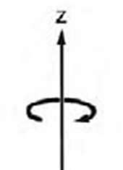
Example: H₂O
Assign a point group
Choose basis function
Apply operations
-if the basis stays the same = +1
-if the basis is reversed = -1
-if it is a more complicated change = 0
C_{2v} point group
Basis: x₁₋₃, y₁₋₃ and z₁₋₃
Atom 1: x₁ = 0
y₁ = 0
z₁ = 0
Atom: 1 2 3
E: 3 + 3 + 3 = 9
Atom 2: x₂ = -1
y₂ = -1
z₂ = 1
C₂: 0 + -1 + 0 = -1
C₂
Atom 3: x₃ = 0
y₃ = 0
z₃ = 0

Slide 17
Example: H₂O
Assign a point group
Choose basis function
Apply operations
-if the basis stays the same = +1
-if the basis is reversed = -1
-if it is a more complicated change = 0
C_{2v} point group
Basis: x₁₋₃, y₁₋₃ and z₁₋₃
Atom 1: x₁ = 0
y₁ = 0
z₁ = 0
Atom: 1 2 3
E: 3 + 3 + 3 = 9
Atom 2: x₂ = 1
y₂ = -1
z₂ = 1
C₂: 0 + -1 + 0 = -1
σ_{xz}
σ_{xz}: 0 + 1 + 0 = 1
Atom 3: x₃ = 0
y₃ = 0
z₃ = 0

Slide 18
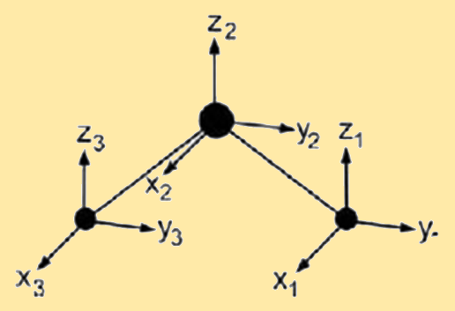
Example: H₂O
Assign a point group
Choose basis function
Apply operations
-if the basis stays the same = +1
-if the basis is reversed = -1
-if it is a more complicated change = 0
C_{2v} point group
Basis: x₁₋₃, y₁₋₃ and z₁₋₃
Atom 1: x₁ = -1
y₁ = 1
z₁ = 1
Atom: 1 2 3
E: 3 + 3 + 3 = 9
Atom 2: x₂ = -1
y₂ = 1
z₂ = 1
C₂: 0 + -1 + 0 = -1
σ_{yz}
σ_{xz}: 0 + 1 + 0 = 1
Atom 3: x₃ = -1
y₃ = 1
z₃ = 1
σ_{yz}: 1 + 1 + 1 = 3

Slide 19
Example: H₂O
Assign a point group
Choose basis function
Apply operations
-if the basis stays the same = +1
-if the basis is reversed = -1
-if it is a more complicated change = 0
Generate a reducible representation
C_{2v} point group
Basis: x₁₋₃, y₁₋₃ and z₁₋₃
Atom: 1 2 3
E: 3 + 3 + 3 = 9
C₂: 0 + -1 + 0 = -1
Γ
9
-1
1
3
σ_{xz}: 0 + 1 + 0 = 1
σ_{yz}: 1 + 1 + 1 = 3

Slide 20
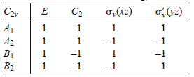
Example: H₂O
Assign a point group
Choose basis function
Apply operations
-if the basis stays the same = +1
-if the basis is reversed = -1
-if it is a more complicated change = 0
Generate a reducible representation
Reduce to Irreducible Representation
C_{2v} point group
Basis: x₁₋₃, y₁₋₃ and z₁₋₃
Γ
9
-1
1
3
Reducible Rep.
Irreducible Rep.

Slide 21
Example: H₂O
Decomposition/Reduction Formula
order (h)
h = 1 + 1 + 1 + 1 = 4
Γ
9
-1
1
3
1
[
]
12
a_{A1} =
(1)(9)(1)
+ (1)(-1)(1) + (1)(1)(1) + (1)(3)(1)
=
= 3
4
4
Γ = 3A₁ + A₂ + 2B₁ + 3B₂

Slide 22
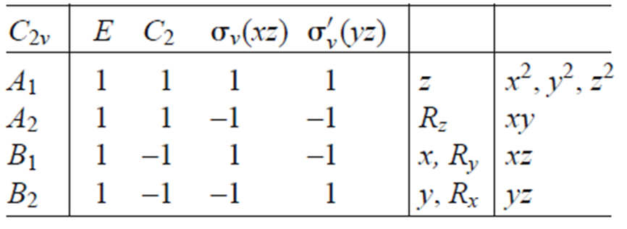
Example: H₂O
Assign a point group
Choose basis function
Apply operations
-if the basis stays the same = +1
-if the basis is reversed = -1
-if it is a more complicated change = 0
Generate a reducible representation
Reduce to Irreducible Representation
Subtract Rot. and Trans.
C_{2v} point group
Basis: x₁₋₃, y₁₋₃ and z₁₋₃
3 atoms x 3 DOF = 9 DOF
3N-6 = 3 Vibrations
Γ = 3A₁ + A₂ + 2B₁ + 3B₂
Trans = A₁ + B₁ + B₂
Rot = A₂ + B₁ + B₂
Vib = 2A₁ + B₂

Slide 23
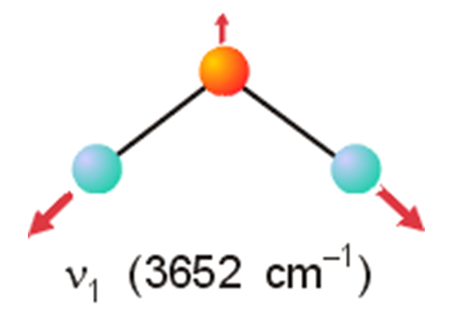
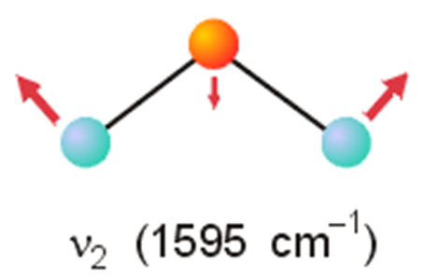
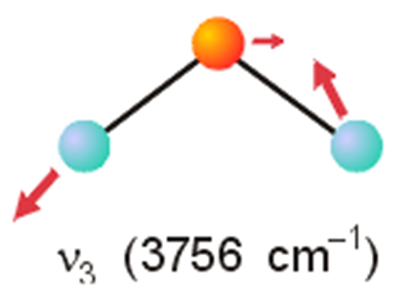
Example: H₂O
Assign a point group
Choose basis function
Apply operations
-if the basis stays the same = +1
-if the basis is reversed = -1
-if it is a more complicated change = 0
Generate a reducible representation
Reduce to Irreducible Representation
Subtract Rot. and Trans.
C_{2v} point group
Basis: x₁₋₃, y₁₋₃ and z₁₋₃
Vibration = 2A₁ + B₂

Slide 24
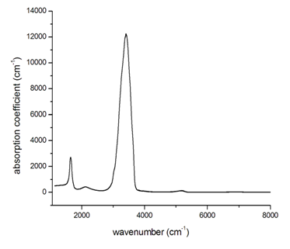
Example: H₂O
Start with a drawing of a molecule
Draw arrows
Use the Character Table
Predict a physically observable phenomenon
C_{2v} point group
Basis: x₁₋₃, y₁₋₃ and z₁₋₃
Vibrations = 2A₁ + B₂
B₂
A₁
All three are IR active but that is not always the case.
A₁

Slide 25
Vibrations and Group Theory
1) Find number/symmetry of vibrational modes.
2) Assign the symmetry of known vibrations.
3) What does the vibration look like?
4) Find if a vibrational mode is IR or Raman Active.

Slide 26
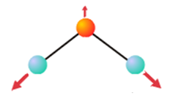
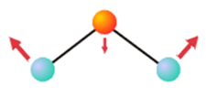
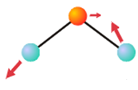
2) Assign the Symmetry of a Known Vibrations
Stretch
Stretch
Bend
Vibrations = 2A₁ + B₂
Bend
Assign a point group
Choose basis function (stretch or bend)
Apply operations
-if the basis stays the same = +1
-if the basis is reversed = -1
-if it is a more complicated change = 0
Generate a reducible representation
Reduce to Irreducible Representation
Stretch

Slide 27
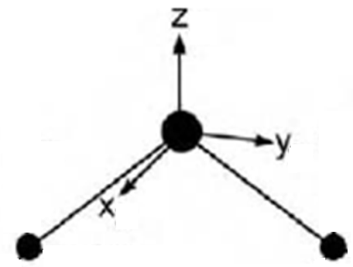
Example: H₂O
Assign a point group
Choose basis function
Apply operations
-if the basis stays the same = +1
-if the basis is reversed = -1
-if it is a more complicated change = 0
C_{2v} point group
Basis: Bend angle
E
E: 1
C₂
C₂: 1
σ_{xz}
σ_{xz}: 1
σ_{yz}
σ_{yz}: 1

Slide 28
Example: H₂O
Assign a point group
Choose basis function
Apply operations
-if the basis stays the same = +1
-if the basis is reversed = -1
-if it is a more complicated change = 0
Generate a reducible representation
Reduce to Irreducible Representation
C_{2v} point group
Basis: Bend angle
Γ
1
1
1
1
Reducible Rep.
Irreducible Rep.

Slide 29
2) Assign the Symmetry of a Known Vibrations
Stretch
Stretch
Bend
A₁
Vibrations = A₁ + B₂
Assign a point group
Choose basis function (stretch)
Apply operations
-if the basis stays the same = +1
-if the basis is reversed = -1
-if it is a more complicated change = 0
Generate a reducible representation
Reduce to Irreducible Representation
Stretch

Slide 30
Example: H₂O
Assign a point group
Choose basis function
Apply operations
-if the basis stays the same = +1
-if the basis is reversed = -1
-if it is a more complicated change = 0
C_{2v} point group
Basis: OH stretch
E
E: 2
C₂
C₂: 0
σ_{xz}
σ_{xz}: 0
σ_{yz}
σ_{yz}: 2

Slide 31
Example: H₂O
Assign a point group
Choose basis function
Apply operations
-if the basis stays the same = +1
-if the basis is reversed = -1
-if it is a more complicated change = 0
Generate a reducible representation
Reduce to Irreducible Representation
C_{2v} point group
Basis: OH stretch
Γ
2
0
0
2
Reducible Rep.
Irreducible Rep.

Slide 32
Example: H₂O
Decomposition/Reduction Formula
order (h)
h = 1 + 1 + 1 + 1 = 4
Γ
2
0
0
2
1
[
]
4
a_{A1} =
(1)(2)(1)
+ (1)(0)(1) + (1)(0)(1) + (1)(2)(1)
=
= 1
4
4
1
[
]
4
(1)(2)(1)
+ (1)(0)(-1) + (1)(0)(-1) + (1)(2)(1)
= 1
a_{B2} =
=
4
4
Γ = A₁ + B₂

Slide 33
2) Assign the Symmetry of a Known Vibrations
Stretch
Stretch
Bend
A₁
Vibrations = A₁ + B₂
3) What does the vibration look like?
By Inspection
By Projection Operator

Slide 34
Vibrations and Group Theory
1) Find number/symmetry of vibrational modes.
2) Assign the symmetry of known vibrations.
3) What does the vibration look like?
4) Find if a vibrational mode is IR or Raman Active.

Slide 35
3) What does the vibration look like?
By Inspection
Γ = A₁ + B₂
Γ
1
1
1
1
Γ
1
-1
-1
1
A₁
B₂

Slide 36
3) What does the vibration look like?
Projection Operator
Assign a point group
Choose non-symmetry basis (Δr₁)
Choose a irreducible representation (A₁ or B₂)
Apply Equation
- Use operations to find new non-symmetry basis (Δr₁)
- Multiply by characters in the irreducible representation
Apply answer to structure

Slide 37
3) What does the vibration look like?
Projection Operator
Assign a point group
Choose non-symmetry basis (Δr₁)
Choose a irreducible representation (A₁)
Apply Equation
- Use operations to find new non-symmetry basis (Δr₁)
- Multiply by characters in the irreducible representation
C_{2v} point group
Basis: Δr₁
For A₁
E
C₂
σ_{xz}
σ_{yz}

Slide 38
3) What does the vibration look like?
Projection Operator
Assign a point group
Choose non-symmetry basis (Δr₁)
Choose a irreducible representation (A₁)
Apply Equation
- Use operations to find new non-symmetry basis (Δr₁)
- Multiply by characters in the irreducible representation
C_{2v} point group
Basis: Δr₁
For A₁
E
C₂
σ_{xz}
σ_{yz}

Slide 39
3) What does the vibration look like?
Projection Operator
Assign a point group
Choose non-symmetry basis (Δr₁)
Choose a irreducible representation (B₂)
Apply Equation
- Use operations to find new non-symmetry basis (Δr₁)
- Multiply by characters in the irreducible representation
C_{2v} point group
Basis: Δr₁
For B₂
E
C₂
σ_{xz}
σ_{yz}

Slide 40
3) What does the vibration look like?
Projection Operator
Assign a point group
Choose non-symmetry basis (Δr₁)
Choose a irreducible representation (B₂)
Apply Equation
- Use operations to find new non-symmetry basis (Δr₁)
Multiply by characters in the irreducible representation
Apply answer to structure
C_{2v} point group
Basis: Δr₁
A₁
B₂

Slide 41
3) What does the vibration look like?
Bend
Symmetric Stretch
Asymmetric Stretch
A₁
A₁
B₂
Molecular Structure
+
Point Group
Find/draw the vibrational modes of the molecule
B₂
=
A₁
A₁
Does not tell us the energy!
Does not tell us IR or Raman active!

Slide 42
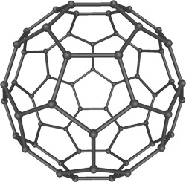
Vibrations of C60
1) Find number/symmetry of vibrational modes.
2) Assign the symmetry of known vibrations.
3) What does the vibration look like?
4) Find if a vibrational mode is IR or Raman Active.

Slide 43
Vibrations of C60

Slide 44
Vibrations of C60

Slide 45
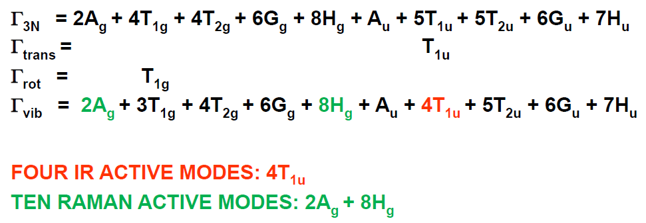
Vibrations of C60

Slide 46
Vibrations and Group Theory
1) Find number/symmetry of vibrational modes.
2) Assign the symmetry of known vibrations.
3) What does the vibration look like?
4) Find if a vibrational mode is IR or Raman Active.
Next ppt!

Slide 47
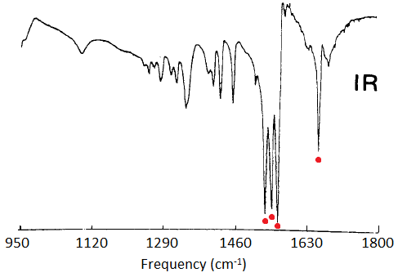
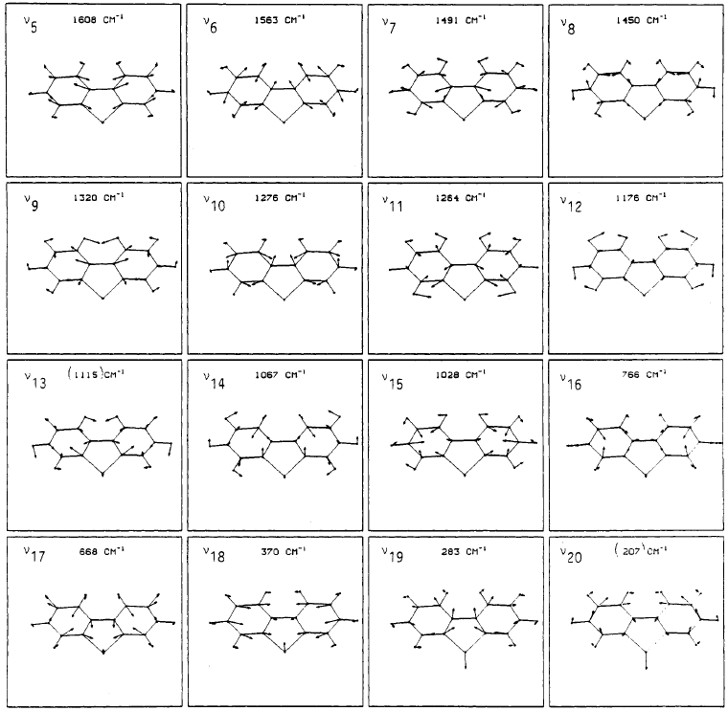
Side note: A Heroic Feat in IR Spectroscopy
C_{2v}: 20A₁ + 19B₂ + 9B₁
Kincaid et al. J . Phys. Chem. 1988, 92, 5628.

